Slide 1

Opening an Indian Restaurant in Toronto
IBM Applied Data Science Capstone Project
By Akhil Halappanavar

Slide 2
Background and Problem Statement
Open an Indian restaurant in Toronto.
To find a location with little or no competition.
Data from various sources, such as Wikipedia, Four square etc. can be used for the project.
Problem statement: Finding neighbourhoods in Toronto with little to no Indian restaurants.

Slide 3
Data Collection
The following sources will be used:
Wikipedia will be used to extract neighbourhood data for Toronto.
The geospatial data from COCL will be used to find the coordinates of the different neighbourhoods.
The Foursquare API will be used to find venues on different locations and to find the neighbourhoods with little or no Indian restaurants.
The folium application in Python will be used to map the data and give an overview of the neighbourhoods.

Slide 4
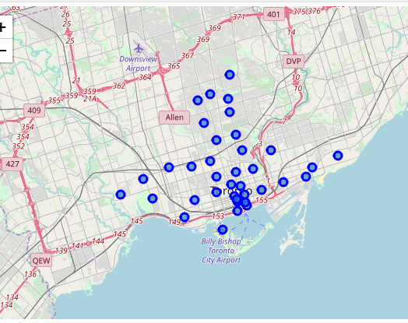
Methodology – Data preparation
The data was cleaned. Boroughs that were ‘Not assigned’ were deleted, as well as ‘Not Assigned’ neighbourhoods.
The latitude and longitude were merged with the neighbourhood data.
The neighbourhoods were mapped:

Slide 5
Methodology – Connecting to Foursquare
All venues from the different neighbourhoods were extracted using the Foursquare API.
The column Indian Restaurant was selected and sorted by frequency.
From the initial 103 rows, 33 rows remained with little or no presence of Indian Restaurants. This was presented in a map.

Slide 6
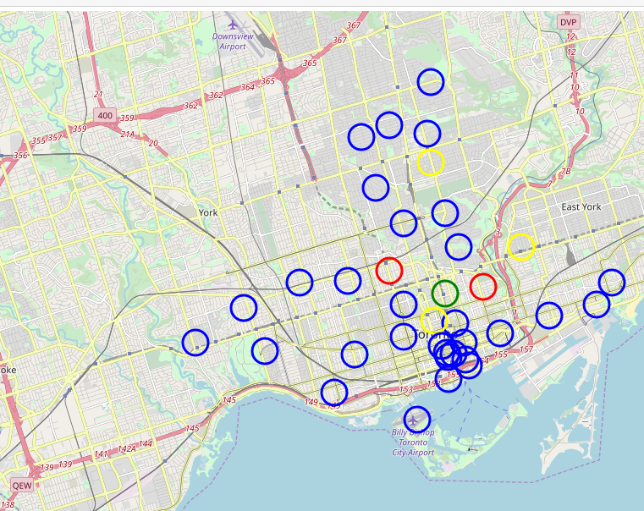
Results
The following map shows the desirable and undesirable neighbourhoods.
Red=high frequency of Indian restaurants
Yellow=medium frequency of Indian restaurants
Green= Low frequency of Indian restaurants
Blue=no frequency of Indian restaurants

Slide 7
Discussion
The neighbourhoods with little or no Indian restaurants have been identified, but we did not look at reviews, demography, etc.
Finding for neighbourhoods with almost none or no Indian restaurants, this might not be the best tactic. It might be better to look at a location with a lot of Indian restaurants that are not excellently rated and try to become the best Indian restaurant in that area.
Now 33 neighbourhoods are selected, the client should come up with more requirement in order to make a more specific selection.

Slide 8
Conclusion
Data science aids in decision making

